Slide 1

Covered Electronic Content in the Revised 508 Standards
2017 Inter Agency Accessibility Forum

Slide 2
WCAG 2.0 Incorporation By Reference (IBR)
508/255 Rule
WCAG 2.0
A
AA
AAA

Slide 3
WCAG 2.0 IBR for Electronic Content
E205.4 Accessibility Standard
Electronic content shall conform to Level A and Level AA Success Criteria and Conformance Requirements in WCAG 2.0 (incorporated by reference, see 702.10.1)
E205.4 continues…
Exception for non-Web documents from the four Success Criteria that are for “sets of Web pages”
E205.4.1 details the word substitution needed to “read” WCAG 2.0 to apply to non-Web documents

Slide 4
What is Electronic Content?
E103 Definitions
Content. Electronic information and data, as well as the encoding that defines its structure, presentation, and interactions
Another Important Definition
Public Facing. Content made available by an agency to members of the general public. Examples include, but are not limited to, an agency Web site, blog post, or social media pages
Notes:
E103.4 Defined terms: Content, Public Facing
E205.4 Accessibility Standard: WCAG 2.0, Level A and Level AA Success Criteria

Slide 5
E205.3 Agency Official Communication
An emergency notification
An initial or final decision adjudicating an administrative claim or proceeding
An internal or external program or policy announcement
A notice of benefits, program eligibility, employment opportunity, or personnel action
A formal acknowledgement of receipt
A survey questionnaire
A template or form
Educational or training materials
Intranet content designed as a Web page

Slide 6
What is Covered Electronic Content
E205.2 Public Facing
Electronic content that is public facing
E205.3 Agency Official Communication
Electronic content that is not public facing
Exception for NARA records

Slide 7
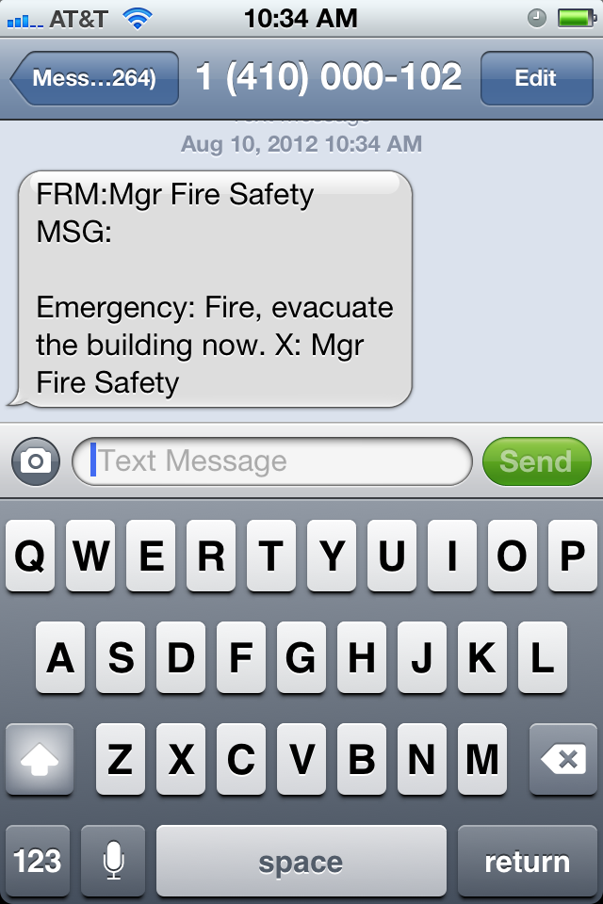
Examples of an Emergency Notification
Evacuation notice
Text messages conveying emergency instructions (e.g., “shelter in place”)
Hazardous weather alert
Operational notices e.g., unscheduled closure

Slide 8
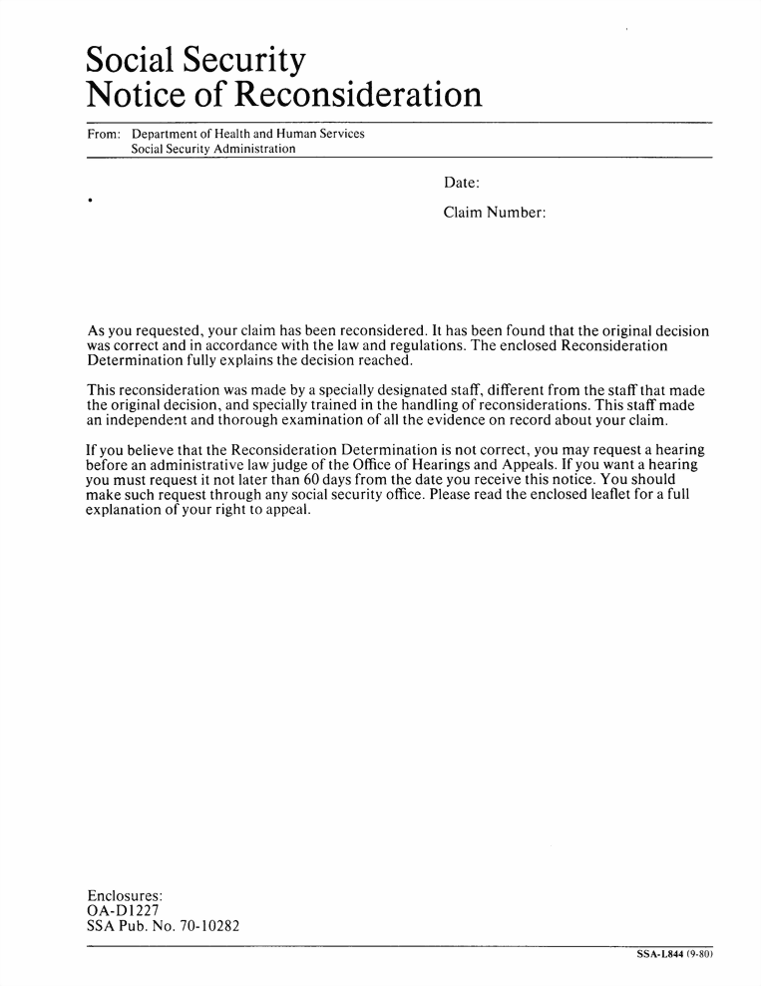
Example of an Initial or Final Decision Adjudicating an Administrative Claim or Proceeding
An electronic notice or alert of an approved, denied, or pending claim sent to a business or other organization, or to an individual

Slide 9

Examples of an Internal or External Program or Policy Announcement
An electronic notification of a new or changed agency policy or program

Slide 10

Examples of a Notice of Benefits, Program Eligibility, Employment Opportunity, or Personnel Action
A notice of government benefits
A notice of program eligibility
Notification of a personnel action indicating a promotion, adverse action, or other decision affecting a government employee
Job announcements
X Not covered content

Slide 11
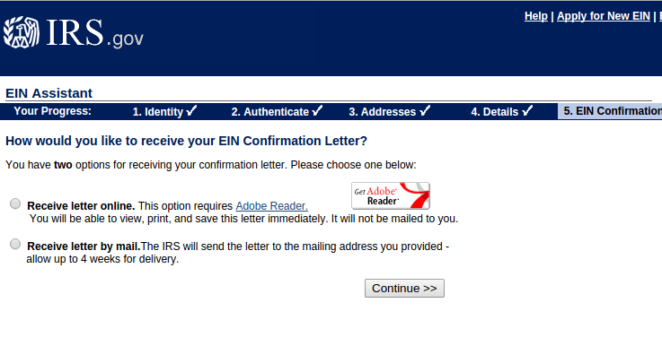
Examples of a Formal Acknowledgement of Receipt
An email acknowledging receipt of payment
A notice posted to a program participant’s web page containing his or her personal account information and acknowledging that he or she successfully submitted certain records

Slide 12
Examples of a Survey Questionnaire
A set of written questions (open-ended or multiple choice) developed for the purpose of a survey or data analysis
This category does not include questions submitted during litigation or legal proceedings
A questionnaire assessing employee training needs
An employee satisfaction survey
A questionnaire used to gather information related to gauging satisfaction with a government program

Slide 13
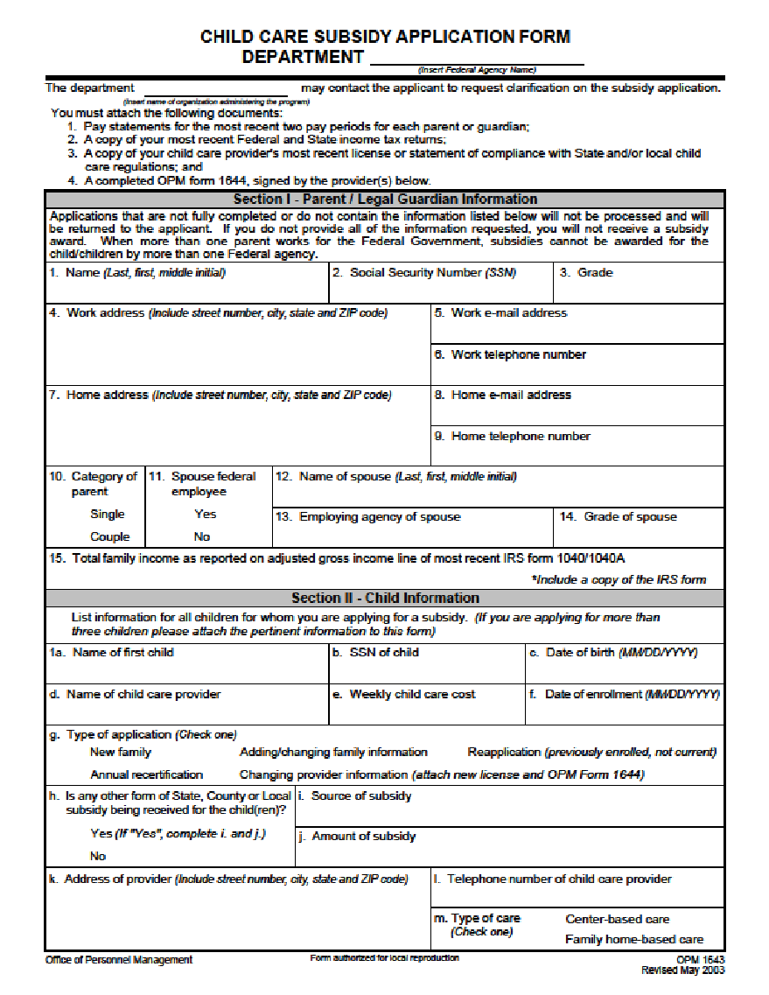
Examples of a Template or Form
An electronic document template used to create official agency documents or presentations
a Web page template created to establish a common look and feel for a website
an official agency form that must be completed by employees or members of the public

Slide 14
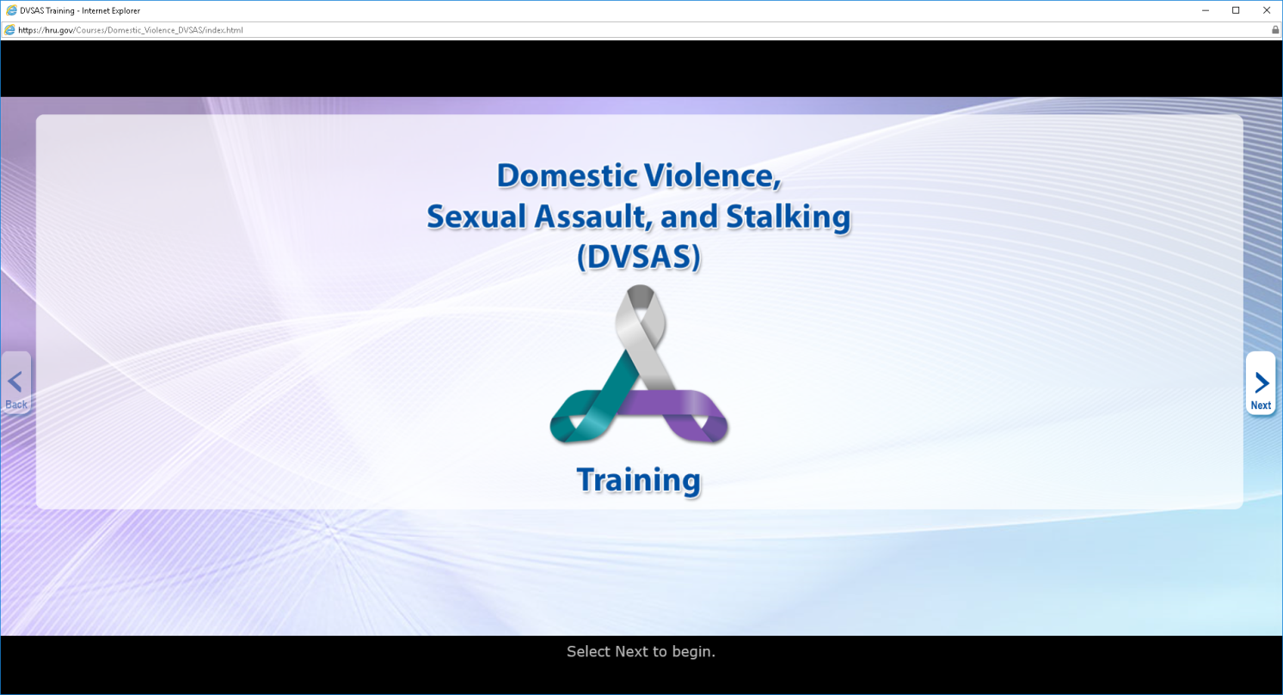
Examples of Educational or Training Materials
Interactive online training courses
Self-paced training course
Educational webinars
Support materials for educational activities including, electronic worksheets, training manuals, or tests

Slide 15
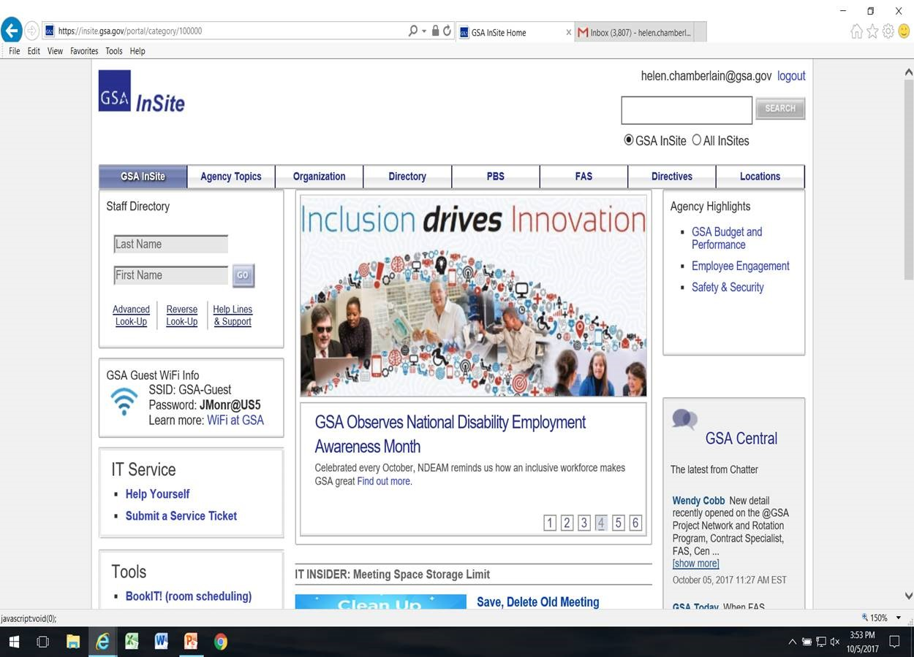
Examples of Intranet Content Designed as a Web Page
HTML Web pages distributed internally via an agency Intranet
An intranet page listing files for downloading
Shared calendars
An internal employee locator
Does not include files within a listing distributed via the agency intranet that are not in one or more of the nine categories

Slide 16

Questions?

Slide 17

U.S. Access Board
(800) 872-2253 (voice)
(800) 993-2822 (TTY)
E-mail: 508@access-board.gov
www.access-board.gov

